Slide 1





“An Investment in Knowledge Pays The Best Dividend”
PRESENTED BY
Val Majewski
Vincent J. Bono, J.D.
Carolyn Marie Tobin, MA
If you have any questions, please email them to Carolyn Tobin:
Carolyn@federalwebinars.com

Slide 2
In the Summer of 2003, the Founders of our company were asked to assess the federal retirement system and the various components of the TSP.
Much to their surprise, they found that the TSP Funds were not truly managed to maximize gains for the federal employees or minimize their losses.
They also found that federal employees were not being shown how to maximize their federal pension or social security incomes, nor were they being taught how to properly plan for their retirement.
Why We Conduct These Webinars
If you have any questions about your federal retirement email Carolyn@federalwebinars.com

Slide 3


Approved Webinar Hosts
Our “Approved Webinar Hosts” are well vetted by us, and experts in helping federal employees better plan for their retirement. By agreement with us, our “Approved Webinar Hosts” do not charge federal employees for any of their retirement consultation services or reports, no matter how extensive their reports or retirement planning advice might be.
Next week, when your Approved Webinar Host contacts you to answer any questions you might have about the content contained in this webinar, we suggest you reach back out to them, and take advantage of their federal retirement planning expertise.
Nothing is ever done in person; it is accomplished on the phone utilizing the internet portals we built exclusively for Federal Employees
If you have any questions about your federal retirement email Carolyn@federalwebinars.com

Slide 4

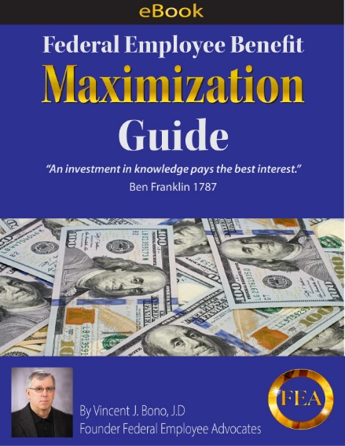
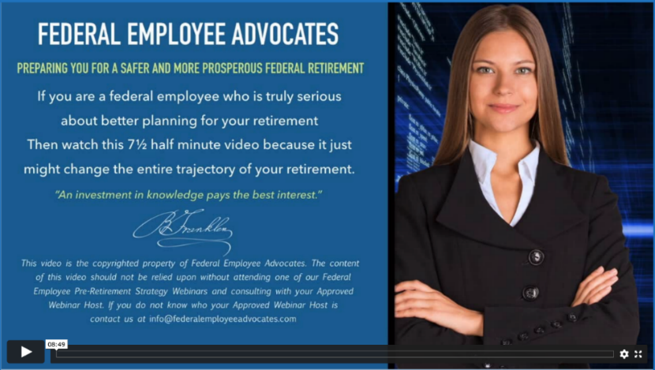
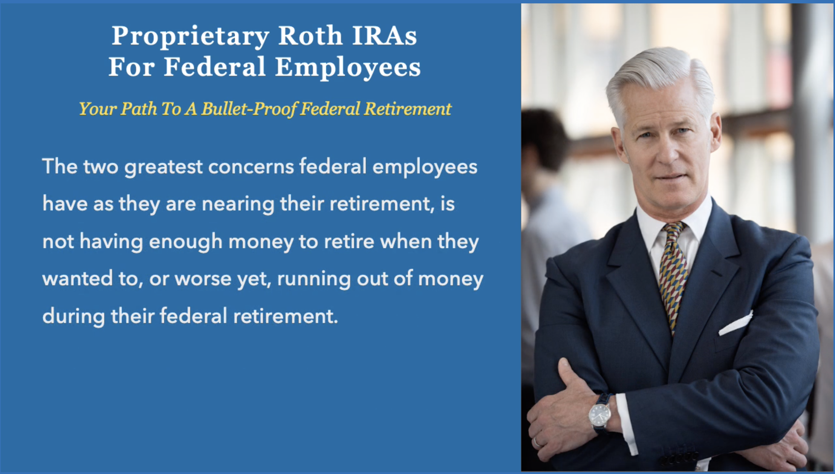
Ask Carolyn For These Free Resources
Carolyn@federalwebinars.com
Online FR80 Calculator Tutorial
eBook
Two “Must See” 6 Minute Videos

Slide 5
Making the right “percentage allocation” between the TSP Funds could add 33% to your account over time.
G Fund: The G Fund buys a nonmarketable U.S. Treasury security that is guaranteed by the U.S. Government, so it can’t lose money.
F Fund: Government, corporate, and mortgage-backed bonds. Attempts to match the performance of the Barclays Capital U.S. Aggregate Bond Index
C Fund: Attempts to match the performance of the S&P 500
S Fund: Attempts to match the performance of the Dow Jones U.S. Completion TSM Index
I Fund: Attempts to match the performance of the MSCI EAFE Index
L Funds: Invested in the G, F, C, S, and I Funds. The closer you are to the Fund Expiration Date (2030, 2040, 2050), the more it is weighted to the G Fund. The Further out the Expiration Date, the more it is weighted to the C, S, and I Funds)
How The TSP Funds Earn Money
If you have any questions about your federal retirement email Carolyn@federalwebinars.com

Slide 6

TSP Fund “Allocation Maximization” Six Undisputed Facts
Fact: During the past 10 years the I Fund earned 50% less than the C&S Funds.
Fact: The I Fund has lost money in years where the C & S Funds made money.
Fact: The G Fund earned 4.22% in 2023, 2.98 % in 2022, 1.3% in 2021 and 2.23% during the past 10 years. In essence the G Fund does lose money because it does not keep up with inflation and there are “lost opportunity costs” associated with owning it i.e. you could have done better with an FIA.
Fact: The L Fund has a significant amount invested in the I Fund and G Fund.
Fact: The C & S Funds have a huge downside exposure because they are “Administered” and not “Managed” to maximize gains and minimize losses.
Fact: If you are retiring within the next 12 years, your retirement savings should not be at risk to lose value…So how do you protect yourself?
If you have any questions about your federal retirement email Carolyn@federalwebinars.com

Slide 7
Time Value Of Money
G Fund Vs. Tax Qualified Alternative
By way of example, if you have $100,000 in the G Fund today, and contribute $5000 a year going forward…
In 20 years, at the historic 2.32% G Fund average interest rate, you would have $288,996.
With a Tax Qualified TSP Alternative that can not lose money due to market conditions, earning 5.25%, you would have $456,933 in 20 years; a $167,937 difference.
Ask Carolyn about this TSP Alternative!
If you have any questions about your federal retirement email Carolyn@federalwebinars.com

Slide 8

Fixed Indexed Annuities: The Best of Both Worlds
They are Safe & Secure
Like your TSP C, S, I & L Funds, Fixed Indexed Annuities participate in the upside of the Stock Market.
Built-In Safety Valves
Unlike those TSP Funds, Fixed Indexed Annuities are not impacted to the downside due to “Stock Market Conditions”.
Unlike those TSP Funds, Fixed Indexed Annuities can not have prior gains “Clawed Back” due to “Market Conditions”.
An example of a Claw-Back is what happened in 2022. If you had your money in the S Fund, you lost 26.66% in 2022, so all of your gains in 2021 and 50% of your gains in 2020 were “Clawed-Back”
If you have any questions about your federal retirement email Carolyn@federalwebinars.com

